Slide 1
Designing multi wavelength optical power meter with raspberry pi
By:
Muhammad Syafiq

Slide 2

BIOGRAPHY
Full Name : Muhammad Syafiq
Place/Date of Birth : Gresik, August 11th 1994
Sex : Male
Married Status : Single
Religion : Moslem
E-mail : syafiqguitarist@gmail.com
Hobby : research, listening music, programming, eksperimen.
Occupation : College Student at Sepuluh Nopember Institut of Technology

Slide 3
DEVICE FRAMEWORK
OPM
Sensor
Photodiode
Signal Conditioning
TransImpedance Amplifier
Data Processing
6 Units of Resistor for Bandwidth Shifting
ADC MCP3204
Raspberry Pi

Slide 4
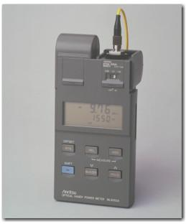
Optical power meter
An optical power meter (OPM) is a device used to measure the power in an optical signal.
Mainly use for measuring power in Fiber Optic System.

Slide 5
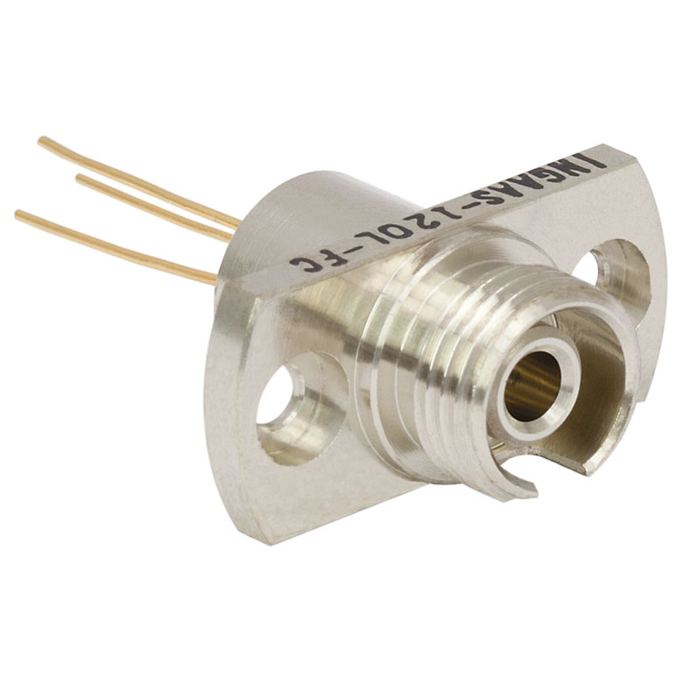
SENSOR
For Sensing the power of the incoming light, we use FGA 01FC InGaAs Photodiode from ThorLabs.

Slide 6
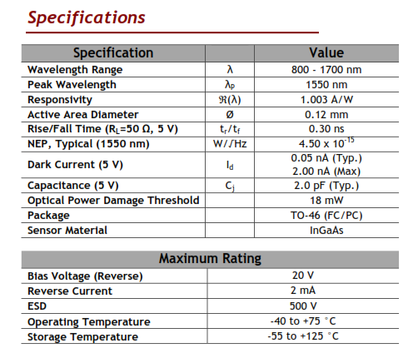

Slide 7
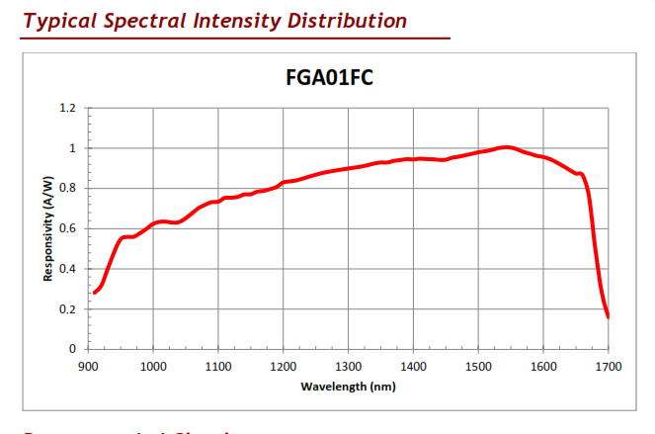

Slide 8
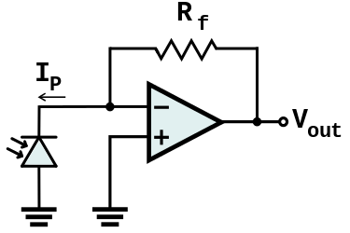
TransImpedance AMPLIFIER
The photodiode is connected between ground and the inverting input of the Op-Amp. The other input of the OP-Amp is also connected to ground. This provides a low impedance load for the photodiode, which keeps the photodiode voltage low. The photodiode is operating in photovoltaic mode with no external bias. The high gain of the opamp keeps the photodiode current equal to the feedback current through R_{f}. The input offset voltage due to the photodiode is very low in this self-biased photovoltaic mode. This permits a large gain without any large output offset voltage. This configuration is used with photodiodes that are illuminated with low light levels and require a lot of gain.

Slide 9
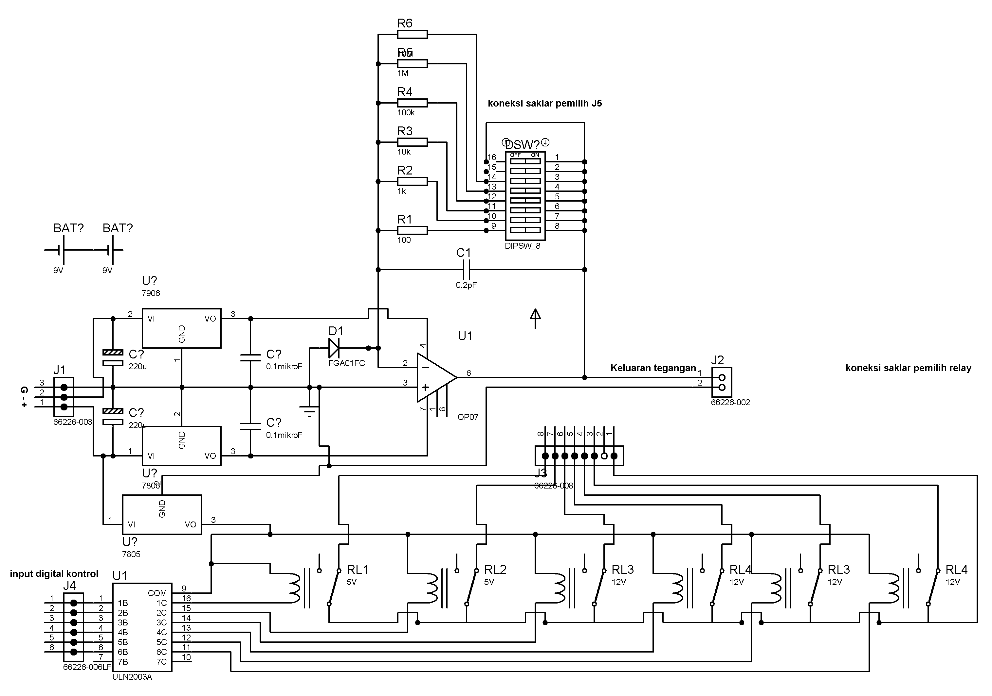

Slide 10
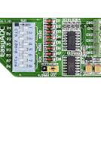
ADC MCP3204
In this section, we use ADC MCP3204 that have been embedded with MCP6208 Op-Amp Gain from mikroElektronika. ADC MCP3204 has 12-bit resolution. In this ADC, we use 5V as power and also for voltage reference.

Slide 11
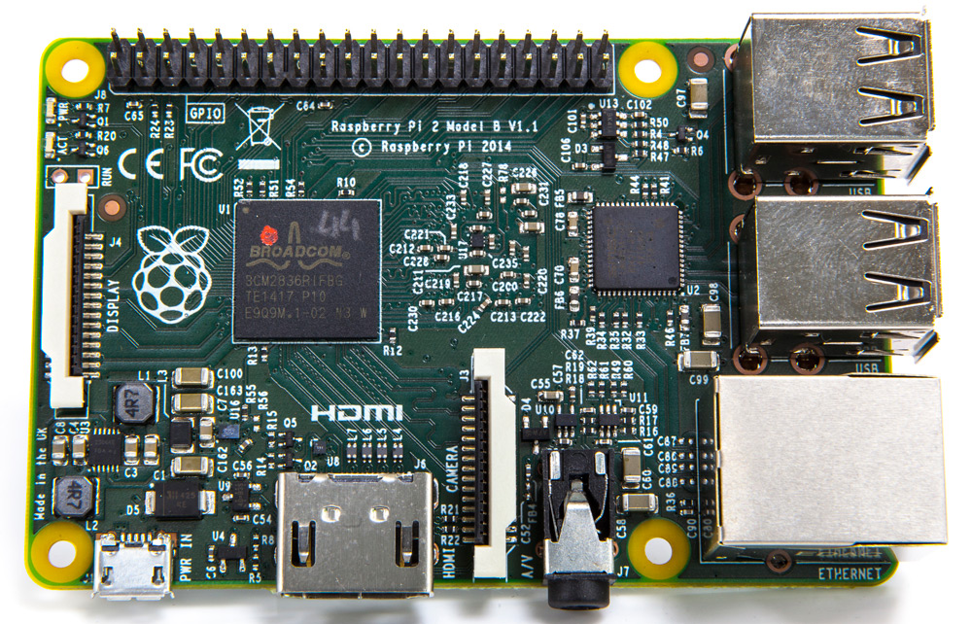
RASPBERRY pi
Raspberry Pi is a SBC (Single Board Circuit) type of microprocessor most recently released by the Raspberry Pi Foundation in 2012 ago. It has many applications such as data processor. The Most use of the Raspberry Pi, that is in the field of network control. Because the base architecture of the Raspberry Pi itself is not much different from the Arduino and other microcontroller. Only the broader features that distinguish Raspberry Pi with other microcontroller.

Slide 12
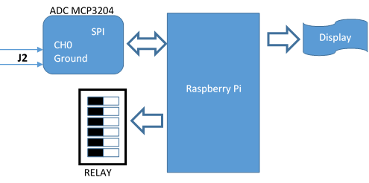
Process flow

Slide 13
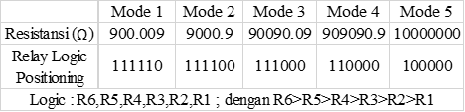
MODE configuration

Slide 14
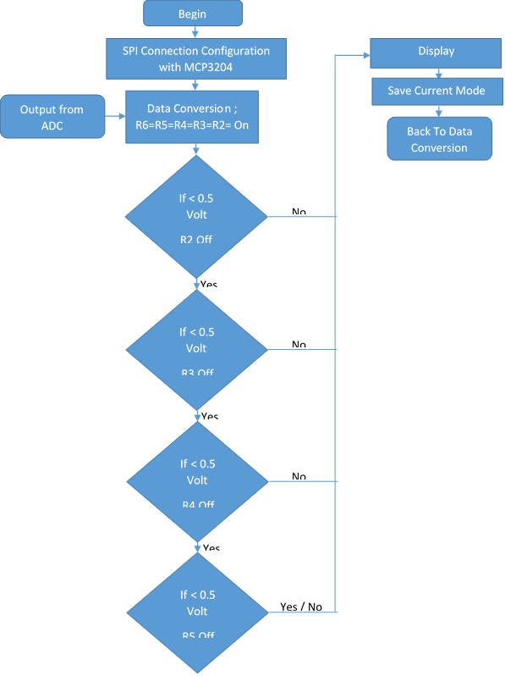
Relay configuration

Slide 15
Python programming for OPM
You can download it at here :
https://github.com/muhsyafiq/OPM-RPi-MultiWaveLength.git

Slide 16
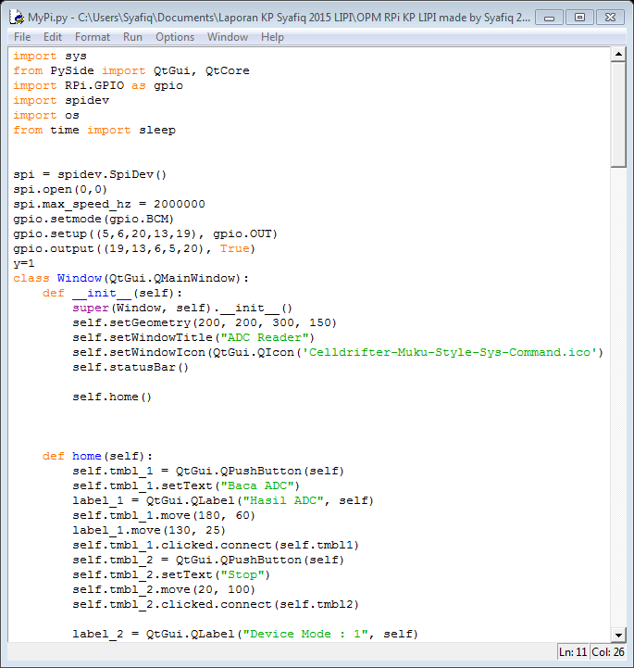
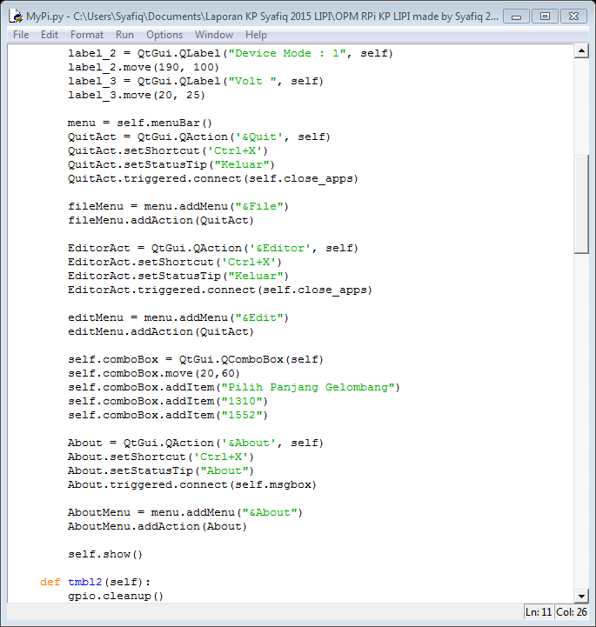
1
2

Slide 17
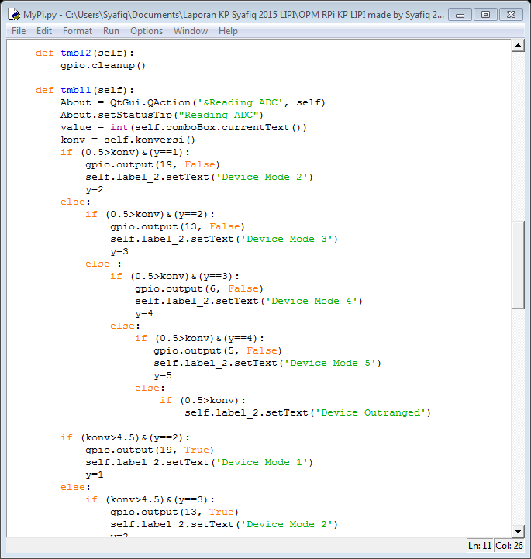
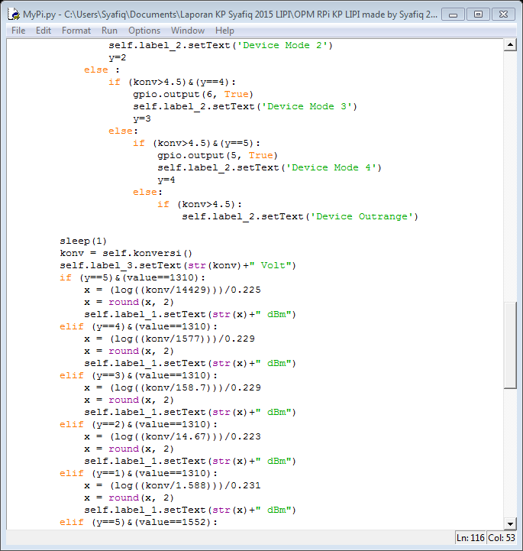
3
4

Slide 18
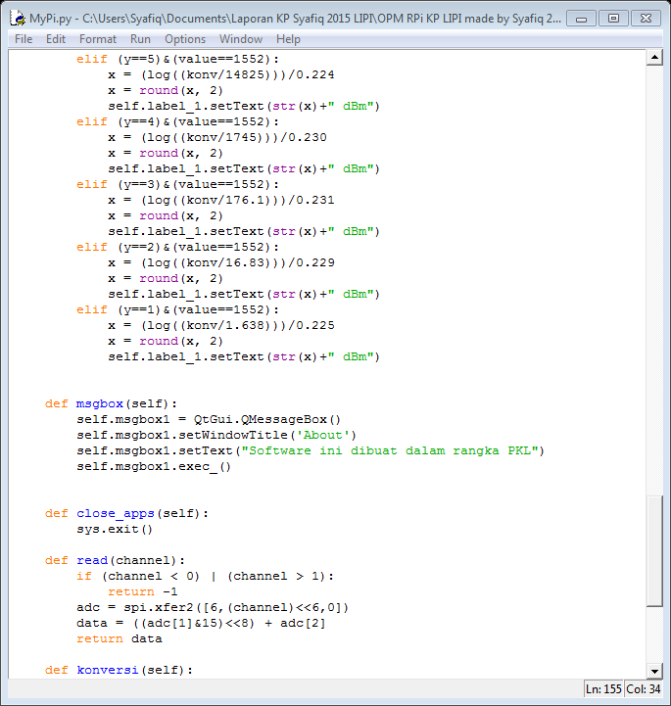
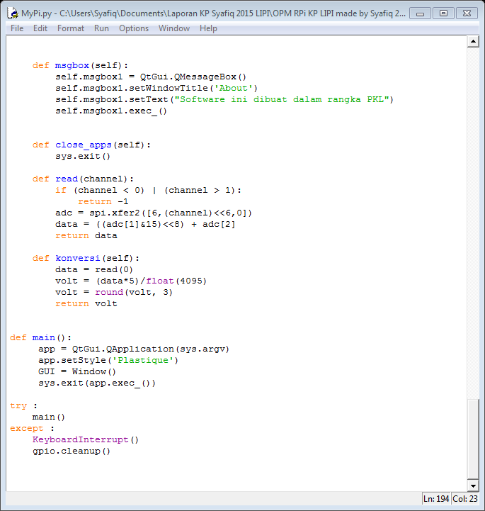
5
6

Slide 19
Result

Slide 20
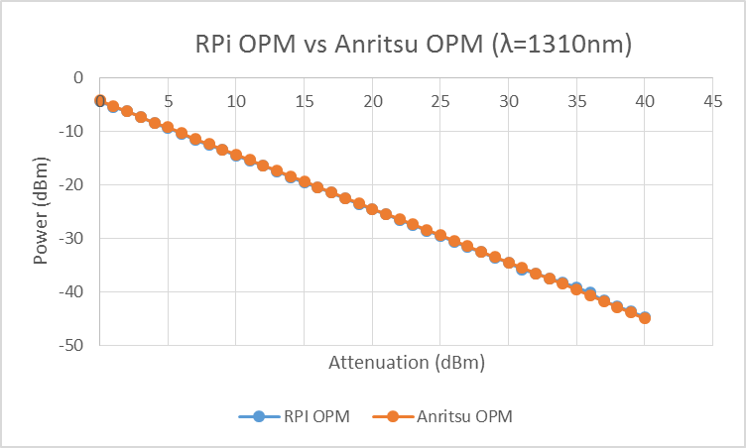
Difference
Maximal | 0.53 dBm
Minimal | 0.01 dBm
Average | 0.149 dBm
See Detail in Excel
(Double click below)

Slide 21

Difference
Maximal | 0.41 dBm
Minimal | 0.03 dBm
Average | 0.155 dBm
See Detail in Excel
(Double click below)

Slide 22
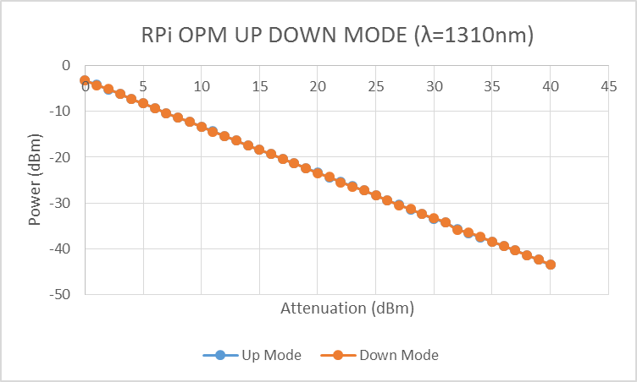
Difference
Maximal | 0.22 dBm
Minimal | 0.00 dBm
Average | 0.049 dBm
See Detail in Excel
(Double click below)

Slide 23
Thank you

Slide 24
ANY QUESTON ?

